Slide 1

WAIŪ– A Celebration Of Sharing Happiness

Slide 2








Truevibez: An Overview
Initiative
Truevibez was established in 2020 with aim to focus on modernization of hospitality industry, by introducing innovative products & features driven by technology evolution.
Mission
To create a global service provider of hospitality industry, realizing pioneering advancements in established services and accomplish mutual growth for both our partners & customers
Programs
Truevibez have designed pioneering programs under WAIU & CLIQUE umbrella, which will drive inventive & original business solutions for both our restaurant partners & consumers for mutual benefit & success.

Slide 3
Founder : Alok Sambuddha
Alok Sambuddha is Engineering Director in American Express, United Kingdom & Director of Truevibez Pvt. Ltd.
Alok is a Mechanical Engineer from Pune University with broad experience in IT industry, working with prominent MNCs as Cisco, Infosys, Atos and now American Express.
Alok’s specializes in merchant acquisition domain and developing technical platforms to support end to end merchant lifecycle services such as affiliation, enablement, submissions, payments, reconciliation, compliance, MIS, AML, Risk, Finance & Accounting.
He also leads solution development framework across technologies like Mainframes, Java, Dot Net, supported via both Agile & Waterfall delivery models. He provides corporate and architectural consultation to business & technology teams to develop flexible solution frameworks & heads the implementation committee.
Alok’s primary geography of operation is Europe (EMEA) and has spent most of his career in Brighton, UK, at the European technology head office of American Express.
Alok has critical presence in merchant management landscape and aims to extend his experience through technical evolution of traditional hospitality business and modernize the F&B service offering for digital citizens in partnership with Rajesh Karandikar.

Slide 4
Founder : Rajesh Karandikar
Rajesh Karandikar is owner of Hotel 24K chain of restaurants in Maharashtra (MH) & Director of Truevibez Pvt. Ltd.
Rajesh is a government media partner as an empanelled member of DGIPR & has executed a range of promotional and awareness campaigns such as:
Edutainment program for Primary & Secondary school in collaboration up with Discovery channel
Cloud seeding program across MH in 2018 under Ministry of Earth Sciences
Executed disaster management week with NDRF for government offices & schools, in 463 tehsils
Rajesh holds MBA in Marketing stream & after spending time at several corporate positions in Delhi, Mumbai & Pune, he applied his entrepreneurial skills in hospitality industry and started the Hotel 24K chain of restaurants, originating in Kolhapur, Maharashtra.
The implementation was an instant success, something which he has now replicated in Pune at premium locations as Balewadi High Street & Viman Nagar IT City. With 3 active restaurants now, Rajesh is also enrolled as an honorary member of Craft Brewers Association of India, successfully running a Craft Brewery in Pune.
To extend his expertise further in hospitality business, Rajesh has founded company Truevibez Pvt. Ltd., with Alok Sambuddha, that aims to explore and introduce innovative technology solutions in hospitality industry to take customer experience to completely new & unexplored levels.

Slide 5
WAIŪ : Vision & Key Features
Vision:
To create a global service provider of hospitality industry, realizing pioneering advancements in established services and accomplish mutual growth for both our partners & customers
Next Level Hospitality Service Offerings
WAIU aims to introduce industry first features in hospitality, keeping the best interest of Restaurant owners and their underserved staff in mind, not just the customers. Key services offered by WAIU are:
Phase One:
Clique : Eat Now-Pay Later for restaurant F&B customers
Clique : Restaurant staff financial lending for their important needs
Phase Two: Following Phase One stabilization in 10 cities
Broadcast & Live Streaming of finest artist performances live in partner restaurant venues
Logistics & Governance to address some of restaurant’s major pain & improvement areas
Gift F&B services to friends, family and even new acquaintances
Socializing & Gaming in premises of restaurant, to promote interaction and upsell
Pre-paid Point Based Services (PBS)

Slide 6



Clique – An Opportunity under Truevibez Umbrella
Clique is premium service offered to our finest customers & business partners, to mutually benefit through means of microfinancing services.
Dine Now, Pay Later
For customer expecting an event to visit restaurant but without available liquid funding, Clique will open up a line of credit in handshake with a lender (NBFC). The customer can request this restaurant-focused credit line and once approved, use it at any partner restaurant. Piloting with 200 restaurants in Pune, we aim to expand to 10 key cities by EOY and have 4000 restaurant partners by 2023.
Merchant Staff Financial Lending
Restaurant staff currently face many challenges in requesting loans from banks and NBFCs however from recommendation of a partner merchants, a low-medium size credit pool will be made available to them with flexible repayment options.
With microfinance market anticipated to grow with CAGR of 40% through 2025, NBFC-MFIs will be its greatest beneficiaries. In F&B segment, unbanked microlending has only reached 12-15% of the prospective market.

Slide 7
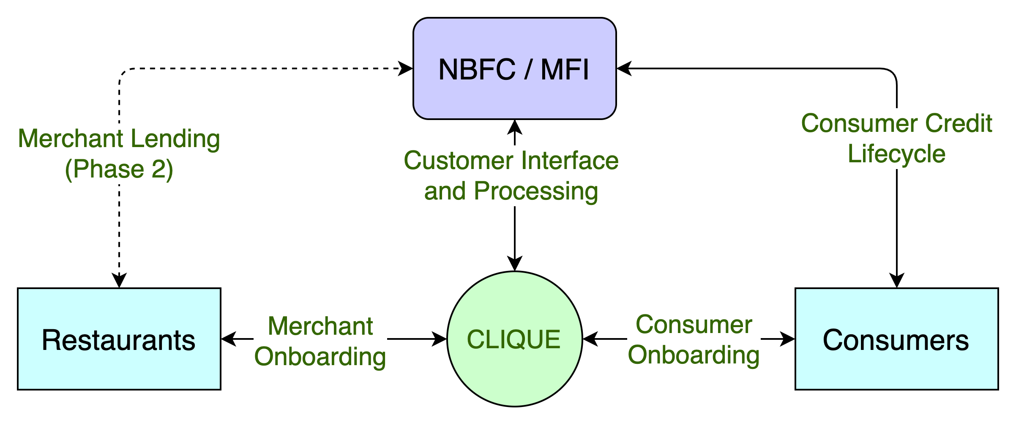
Clique – High Level System Flow
CASE STUDIES
Zomato, in partnership with InCred, to lend Rs 1L to 50k restaurants, developing loan book of 500CR
PAYO (Australia) – Launched ENPL service in July-21 & already has 500+ restaurant partners

Slide 8
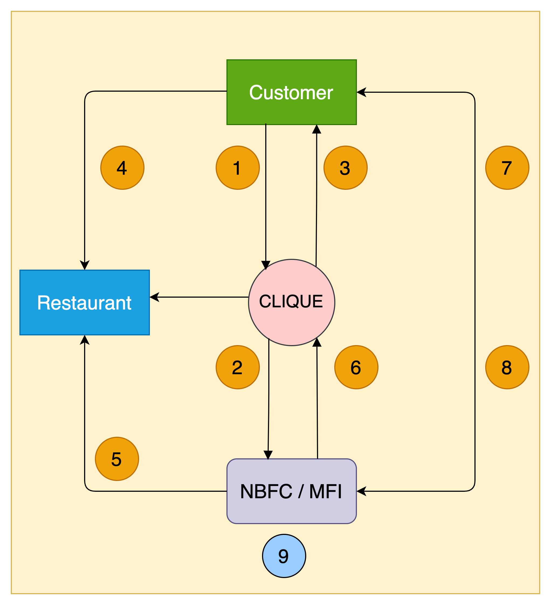
Clique – High Level Transaction Process Flow
1. Customer walks into a restaurant & applies for the wallet credit through Clique App
2. Clique receives customer application & send it to the lender for underwriting & respond with approval or rejection
3. Customer app wallet is credited with approved funds & signs NACH mandate
4. Customer utilises the wallet credit at the restaurant e.g., Rs 5000
5. Lender pays the merchant (less the operational charges) based on merchant's billing cycle e.g., Rs 4500
6. Lender pay the commission to Clique e.g., Rs 400 based on payment reconciliation, on agreed frequency
7. Customer pays lender later based on agreed T&C,
including interests, delay charges etc.
8. Once paid, even if partially, lender updates Clique to reset
customer’s wallet for calculated funds for further utilisation
9. Lender keeps the balance i.e., Rs 100, for their services

Slide 9
Merchant – Elevated Pitch
Increased Profit Margins
Of restaurants by onboarding brand new customers & rotate existing customer more often
Cross Industry Alliance
Merchants to benefit from Clique partnerships like Pune Mirror, Sakal, Banks & Lenders
New Product & Features
To be offered to customers for extended loyalty & addition premium clientele
Larger Ticket Size
Eat Now Pay Later customers to spend an average of 15-30% higher on F&B services
High Customer Retention
To continue their quality service & more to existing customers without any additional expense
Merchant, Staff & Consumer Lending
To support merchant financial needs without bank audit & documentations

Slide 10
Customer – Elevated Pitch
New Product & Features
Credit line facility for F&B services during need and additional guaranteed benefits of dining out
New Borrowing Avenue
By utilizing existing relationships and financial network portfolio in an organized & professional manner
Bio-Authorization For Enhanced Safety
Reactive Credit Scoring
To allow customers to increase credit line for more benefits & increased financial literacy
Best Rates & Flexible Terms
With long risk-free no-interest paying term, along with a range of payment plans at offer with different lenders to choose from
No Fees & Ease of Use
Simple to use service without any hidden costs, allowing decorum & savings
On Demand Spending Potential
No more dependency on regular cash flows & a flexible solution for all occasions combined with increased risk-free spending potential

Slide 11







PAYO (Australia) – A case study
About PAYO
PAYO is an Australian company who have launched the world’s first Eat Now, Pay Later service in July 2021.
The are backed by an existing lender with substantial customer base in the operational regions.
Being the World’s first ENPL app, they have favorably placed themselves as market disrupters, driving investor’s interest & confidence.
Within 3 months of launch, 700+ merchants in 4 cities & growing at the pace of 200 merchants every month
All payments are divided across 4 interest free EMIs, with only a quarter of payment to be made upfront.
Top performing 50 restaurants have received thousands of transactions with recorded order value increase of 60%
Diners can discover restaurants, filter by preferences, call restaurant, book table and receive range of offers & deals.
Both restaurants & customers are incentivized for referring more paying users to the platform
All payments are via PAYO app via QR codes with options for customer to recommend for PAYO business
Instant approval & discreet process has given PAYO an edge over other modes of payments, eliminating need to carry wallets

Slide 12
Corporate Partnership
S. No. | Partner | Role
1 | NPCI | Nth Reward Loyalty platform onboarding & campaigning platform
2 | Cosmos Bank | Value add service to bank customers via bank's super-app
3 | KPMG | RBI regulatory compliance and licensing services
4 | Payu Finance (Lazypay) | Financial lending service provider
5 | Paytm | Financial lending service provider
6 | Early Salary | Financial lending service provider
7 | LoanTap | Financial lending service provider
8 | Michael Dell Foundation | Financial lending service provider
9 | Suniel Shetty (Popcorn Entertainment) | Brand Ambassador
10 | TOI, Pune Mirror | Media & Advertorials
11 | SonyLiv | Entertainment and broadcast services
12 | Stratacache (SCALA) | Broadcast infrastructure and CDN
13 | Sazinga Digital | Technical platform development & maintenance

Slide 13
Our Team
Promoters
Rajesh Karandikar
Alok Sambuddha
Board Of Advisors
Suhas Gokhale : Managing Director, COSMOS Bank, Pune
Rahul Renavikar :Managing Director, Acuris Advisors (GST & Government Policies) – Ex. Big 4 & Tata Motors
Chetan Oswal : Accounts & Legal Counsel
Shrikant Chatur : Governance Consultant (ex. VP Commercial - Cummins)
Sanjay Phadke : Fintech Specialist, Ex. EVP Edelweiss & Vayana Network, JP Morgan, HSBC
Rakesh Malhotra : Media Curator, Ex. Media Head - Sakal
Yogesh Katre : Sales Head, Loantap
Harun Rashid Khan : Regulatory Advisor, Ex. Deputy Governor RBI
Vinay Baijal : Regulatory Advisor, Ex. CGM Banking, RBI

Slide 14






Question & Answers

